Slide 1
CAPSTONE PROJECT
AGRICULTURE LAND ANALYSIS
BY : Y.HARISH KUMAR
SREE KRISHNA COLLEGE OF ENGINEERING

Slide 2
OUTLINE
○ Proposed System/Solution
○ System Development Approach
○ Algorithm & Deployment
○ Result
○ Conclusion
○ Future Scope
○ References

Slide 3
Proposed System/Solution
Choose appropriate machine learning models such as regression (e.g., linear regression, random forest regression) or classification (e.g., decision trees, SVM) based on the nature of the problem (e.g., predicting crop yield, classifying soil types).Split data into training and testing sets for model evaluation.

Slide 4
System Development Approach
Computing Device: Any modern computer or laptop can be used for Python development. The specifications will depend on the complexity of your tasks. For basic scripting and small projects, a standard laptop with at least 4GB of RAM and a multi-core processor will suffice. For more intensive tasks such as machine learning or data analysis on large datasets, a computer with higher RAM (8GB or more) and a faster processor (e.g., Intel Core i5 or higher) is recommended.
Python Interpreter: The core requirement is the Python interpreter itself, which can be downloaded from the official Python website (python.org). Choose the latest stable version compatible with your operating system (Windows, macOS, Linux).

Slide 5
Algorithm & Deployment
Algorithm Selection:Regression Algorithms: If you're predicting continuous variables like crop yield, consider regression algorithms such as linear regression, random forest regression, or gradient boosting regression.
Model Training and Evaluation:Split your data into training and testing sets (e.g., using train-test split in Scikit-learn).Train your chosen algorithm on the training data.Evaluate the model using appropriate metrics based on your task (e.g., RMSE for regression, accuracy for classification).

Slide 6
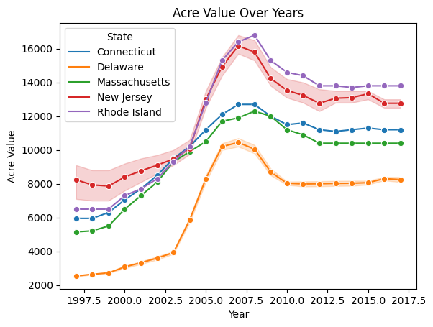
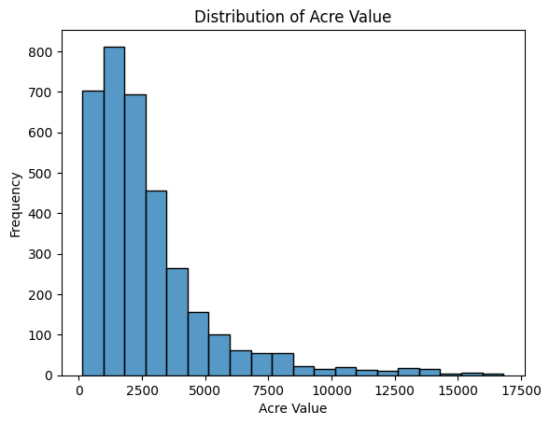
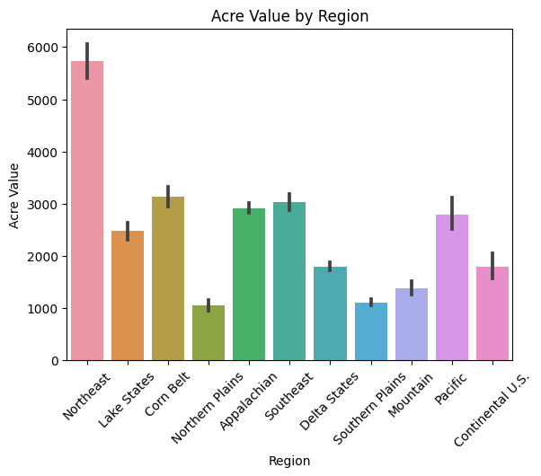
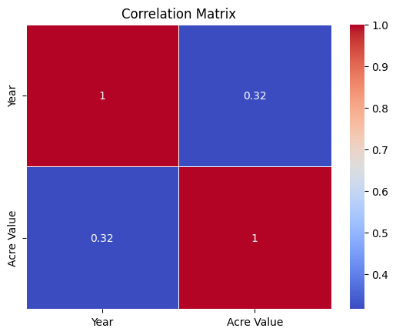
Result

Slide 7
Conclusion
In conclusion, conducting agriculture land analysis in Python involves a comprehensive approach encompassing data collection, preprocessing, exploratory data analysis, feature engineering, model selection and training, evaluation, and deployment.

Slide 8
Future Scope
Integration of Big Data and AI: As agricultural datasets continue to grow in volume and complexity, there will be an increased focus on leveraging big data technologies and advanced AI algorithms. This includes using machine learning models for predictive analytics, anomaly detection, and optimization of agricultural processes.
IoT and Sensor Integration: The integration of IoT devices and sensor networks will play a significant role in agriculture land analysis. This includes real-time monitoring of soil moisture, temperature, crop health, and environmental conditions. Python can be used to develop IoT solutions, data aggregation pipelines, and analytics platforms for actionable insights.

Slide 9
References
https://youtu.be/zdd1sViJK1w?si=kdEAOvU80ztpaFpr

